Slide 1

Final Report
Enterprise Credit Rating
Using machine learning method, multiple algorithm and financial knowledge
Group member：陈云轩、王俊蘅、仇实、陈以庭、陈琪颖

Slide 2

01
Problem description
Why choose this topic? What’s the purpose and worth?
02
Data collection
How we collect data? What kind of data to collect?
Contents
03
Feature engineering
In face of raw data in a mess, how we transfer to appliable data
04
Model formulation & Evaluation
From Logit model, neural network, decision tree to ensemble learning
05
Implication and insight
Explanatory research using financial knowledge.

Slide 3
01
Problem Description
Why we choose the topic? What’s the reality meaning of it?

Slide 4

Problem description
Why we choose the topic? What’s the reality meaning of it?
What is enterprise credit rating?
It refers to the activity of credit rating agencies to evaluate the credit rating of collected enterprise credit information based on certain financial indicators, such as P/E ratio, Sharpe ratio, liquidity risk and so on
It is an important indicator to determine our investment on the enterprise or cooperation with the enterprise
Why is it worth a project?
Enterprise credit rating system is quite mature in US, such as Standard & Pools, Moody’s Investor Services, and Fitch Ratings International. On the contrary, that in CN is still a youngster.
Credit rating can reduce information asymmetry between investors and enterprise, making the market more efficient.
Since the rating is given by a company , why can’t we learn the process and give a similar rating?

Slide 5
02
Data Collection
How we collect data? What kind of data to collect?

Slide 6
Data collection
How we collect data? What kind of data to collect?
Reading papers…
Correlation analysis…
Grab the data…
[1]刘晨蕊. 基于BP神经网络的绿色债券信用评级研究
[2]And so on……
Many indicators is highly correlated, such as Current Ratio and Quick Ratio
We grab the data from CHOICE of East Money

Slide 7
03
Feature Engineering
How we transfer raw data to appliable data

Slide 8
Feature Engineering
Variable Selection
Since the data we get have too many variables and some variables are highly related to each other.
We read some articles about companies’ credit rating, and use the variables most article chose.
variables selected

Slide 9
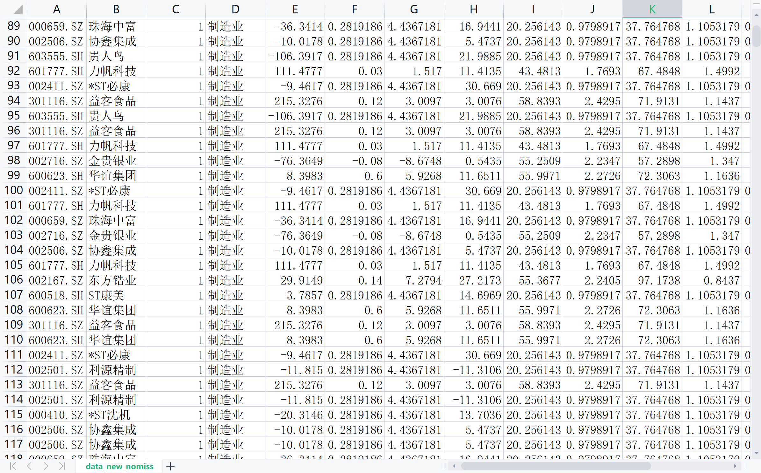
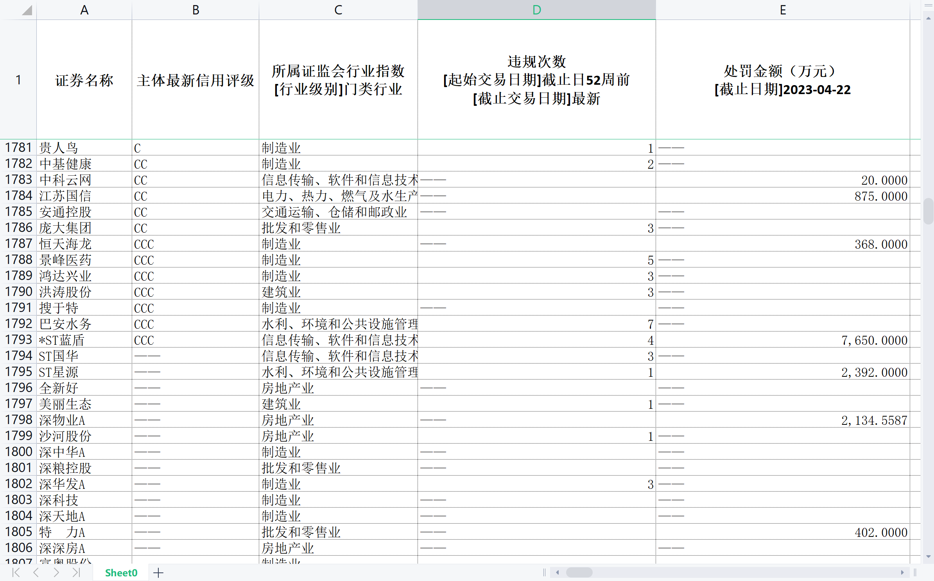
Feature Engineering
Imputation of missing values
Categorize our data into different industries
For each industry, use the mean value to replace the missing one

Slide 10
04
Model Formulation
From Logit model, neural network, decision tree to ensemble learning

Slide 11



Why choose Neural Networks
Logistic regression
01
After a simple attempt at multi-categorical logistic regression, we found that its accuracy remained around 0.4, which was not a suitable model choice.
Neural Networks
Therefore, we decided to try neural networks, because with a certain amount of data and indicators, neural networks can learn more complex relationships and better adapt to incomplete data and noise, which are the problems that our dataset faces.
02

Slide 12
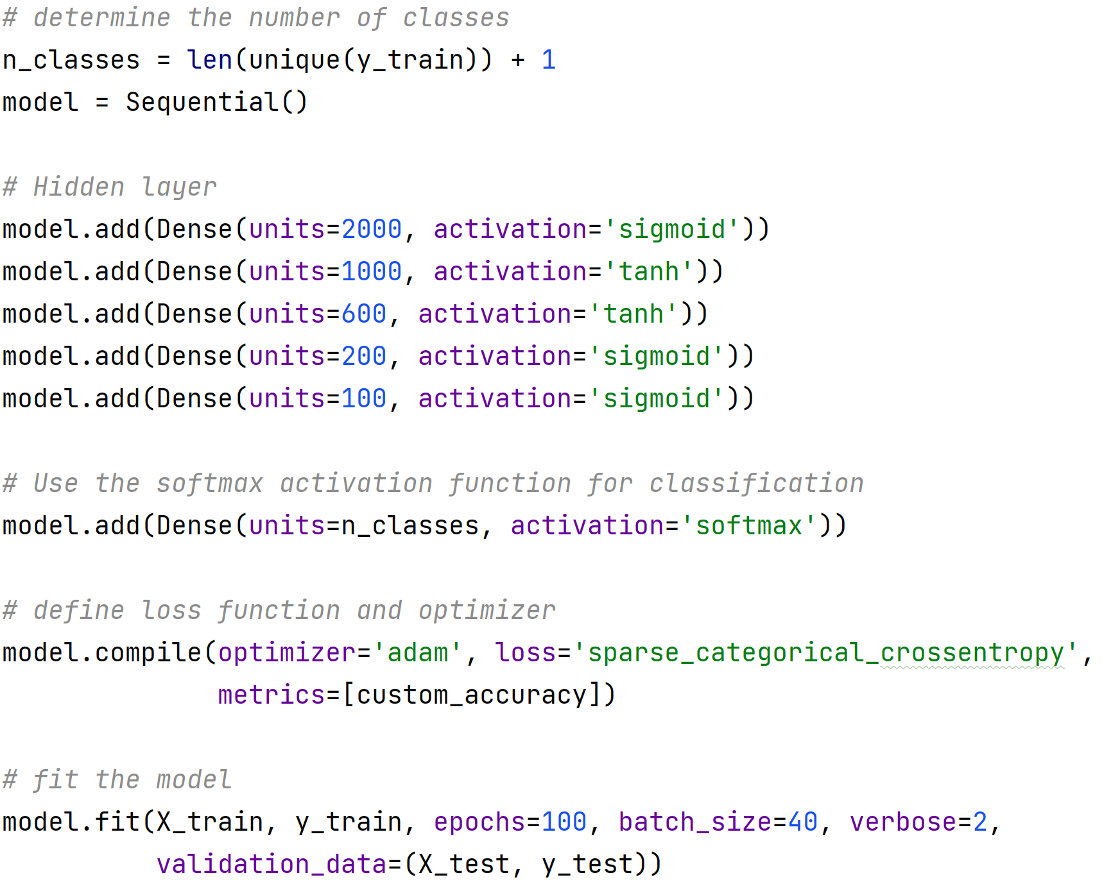
Model formulation & Algorithm implementation
Neural Networks
After many attempts, we finally confirmed the model with five hidden layers and one output layer, and gradually fine-tuned the parameters until the illustrated state. As for the activation function, we choose sigmoid for hidden layers and softmax for classification and we believe that the combination of these two is the optimal solution for this model. In terms of training times, we found that the accuracy of testing set increased in the first 80 epochs, and after that, it showed a trend of overfitting, so we set 80 epochs

Slide 13
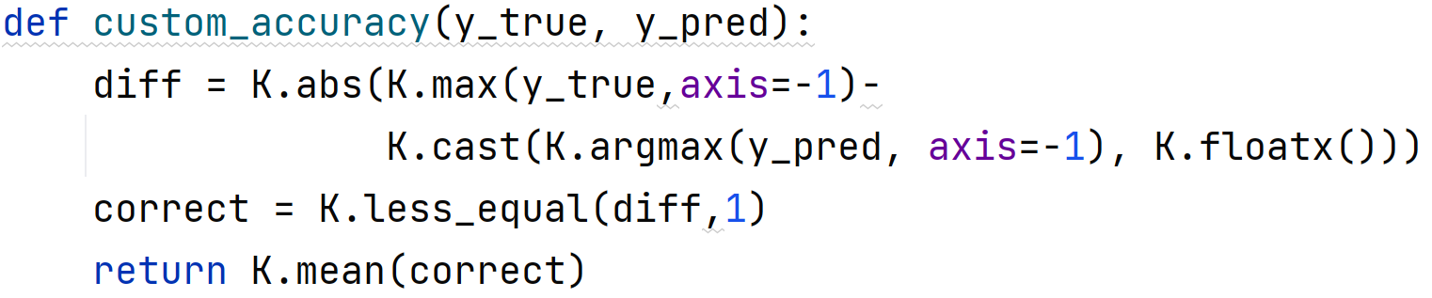
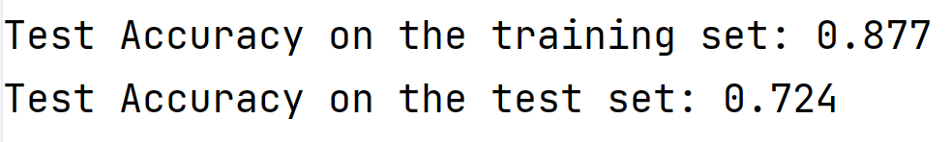
Model Evaluation
Accuracy
In terms of measuring accuracy, we have set a new accuracy equation. After setting the rating at 19 levels, we believe that an error of 1 between the predicted value and the actual result can be considered a relatively accurate result. After 80 epochs, we achieved a relatively good accuracy.
However, it is rather difficult to continue improving accuracy using neural networks. Therefore, we have decided to turn to decision trees to further improve accuracy.

Slide 14
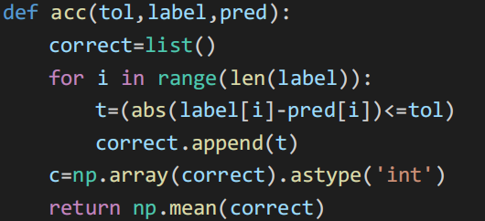
Decision Tree
Model Training
Since our project is about a classification problem, decision tree is also a good choice to do the prediction and classification.
Besides, due to our classification is related to rank, some tolerance is needed to do the prediction, so we define the acc() function to calculate the predicting accuracy.

Slide 15
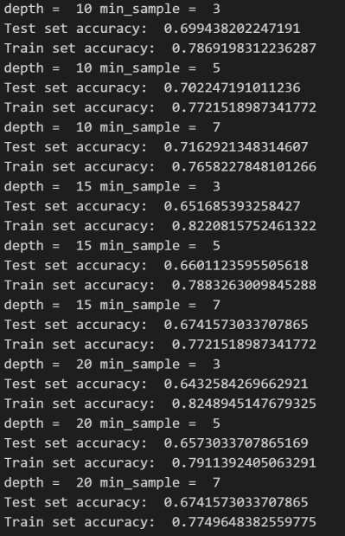
Decision Tree
Model Training & Evaluation
With pre-processed data, we divide data into train set and test set and started the model training of decision tree.
By changing the parameter in tree.DecisionTreeClassifier() function, we attempted to find out the local best solution.
As is shown in the output, we can conclude that train accuracy increases when tree depth increases,
but test accuracy decreases when tree depth increases, which is due to overfitting.
Also, train accuracy increases when min sample decreases, but test accuracy decreases when min sampledecreases.
To balance overfitting and accuracy, we choose tree depth=15, min sample = 5.

Slide 16
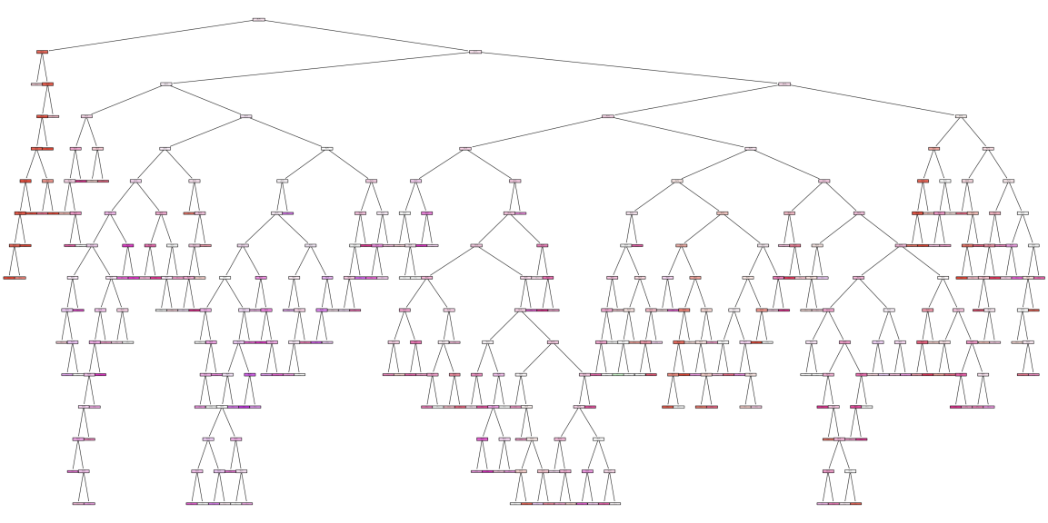
Model Visualization & Algorithm Implementation
The decision tree picture shown above is very complex, which is due to our various classification, though we don’t have so many features. However, it also gives us relatively high accuracy.

Slide 17
Ensemble Learning
Heterogeneous
Homogeneous

Slide 18
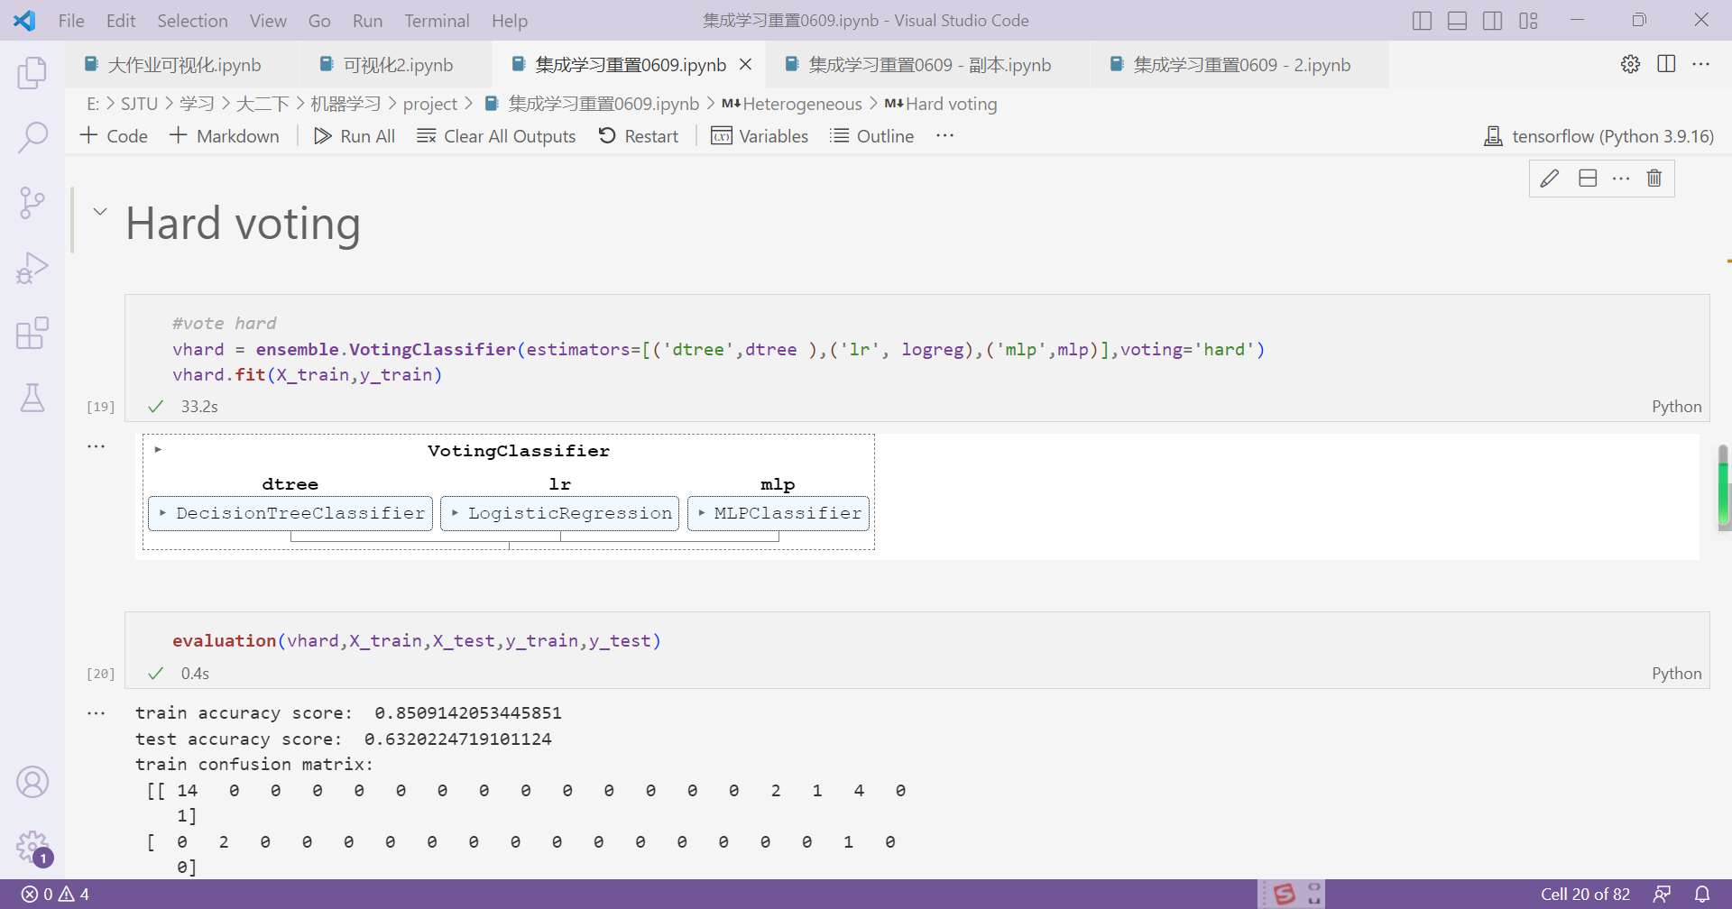
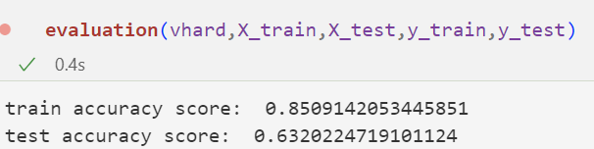
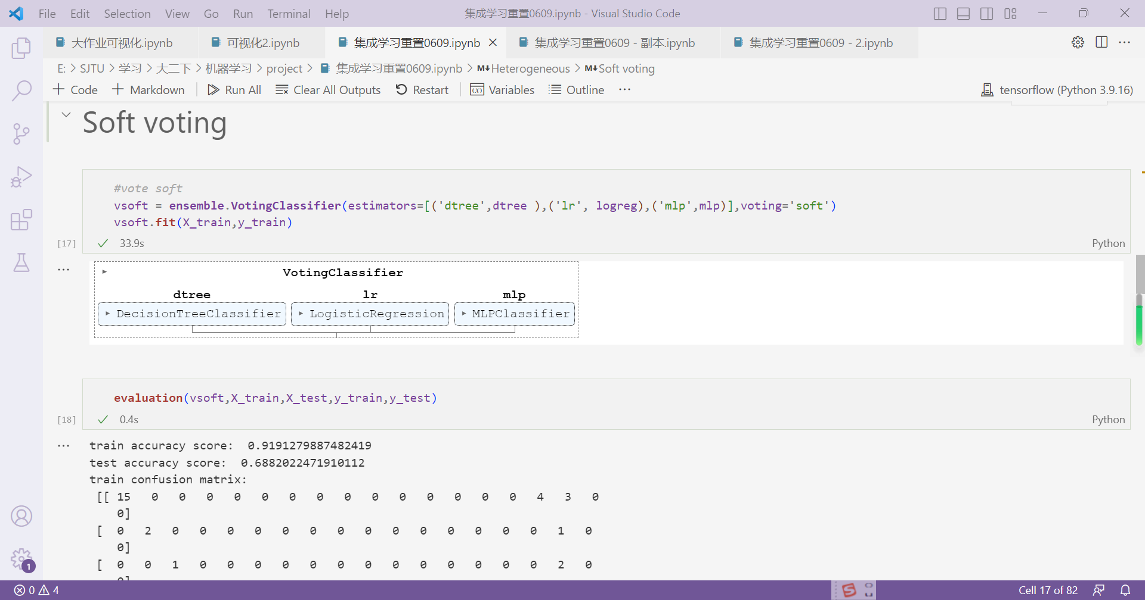
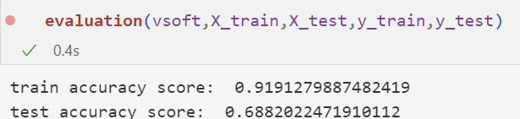
Ensemble Learning
Heterogeneous
Voting
Evaluation of Voting
Hard Voting
No better score and very slow
Majority/Hard Voting——the class label represents the majority (mode) of the class labels predicted by each individual classifier
Weighted Average Probabilities (Soft Voting)——returns the class label as argmax of the sum of predicted probabilities
Soft Voting
Better score but also very slow
There was no significant improvement in the performance of voting compared to component learners. This may be because although we follow the heterogeneity requirements of the voting algorithm for component learners when processing, high-quality voting also requires that component learners have relatively similar effects (not satisfied).

Slide 19
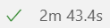
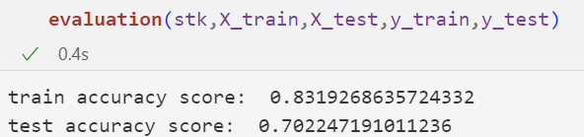
Ensemble Learning
Heterogeneous
Stacking
Evaluation of Stacking
Better score but very slow
The predictions of each individual estimator are stacked together and used as input to a final estimator to compute the prediction.
This final estimator is trained through cross-validation.
Although this algorithm has better performance, the running speed of the algorithm is much slower than other algorithms.

Slide 20
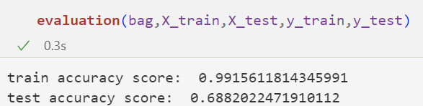
Ensemble Learning
Homogeneous
Evaluation of Bagging
Bagging
Bagging classifier is an ensemble meta-estimator that fits base classifiers each on random subsets of the original dataset and then aggregate their individual predictions to form a final prediction
It can be seen that the classification performance of bagging is not as good as that of stacking.

Slide 21
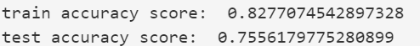
Ensemble Learning
Homogeneous
Evaluation of Random Forest
Random Forest
Random forests are known to prevent over-fitting, but when we first tried with the initial parameters, we found that there was over-fitting (the appearance of this unusual over-fitting may be related to the evaluation index we use).
After tuning the parameters for max_depth and min_samples_leaf, we got better results.
Random Forest classifier is a meta estimator that fits a number of decision tree classifiers on various sub-samples of the dataset and uses averaging to improve the predictive accuracy and control over-fitting.

Slide 22
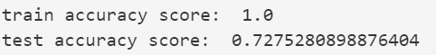
Ensemble Learning
Homogeneous
Evaluation of Extra Trees
Extra Trees
Extra Trees classifier implements a meta estimator that fits a number of randomized decision trees on various sub-samples of the dataset and uses averaging to improve the predictive accuracy and control over-fitting.
In the case of high accuracy of the base learner, Extra Trees can achieve better results, but the data set we used obviously does not satisfy this requirement.
In this case, the extra randomness of Extra Trees makes the deviation greater, and the effect is not as good as Random Forest.

Slide 23
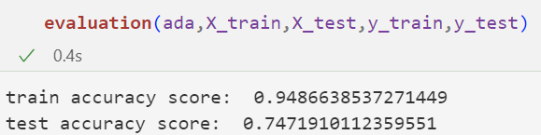
Ensemble Learning
Homogeneous
Evaluation of AdaBoost
AdaBoost
AdaBoost classifier is a meta-estimator that begins by fitting a classifier on the original dataset and then fits additional copies of the classifier on the same dataset but where the weights of incorrectly classified instances are adjusted such that subsequent classifiers focus more on difficult cases.
The number of weak classifiers and related parameters of AdaBoost are difficult to adjust, and AdaBoost is obviously affected by data imbalance.
At the same time, the stability of AdaBoost is poor and it is easy to be affected by outliers.

Slide 24
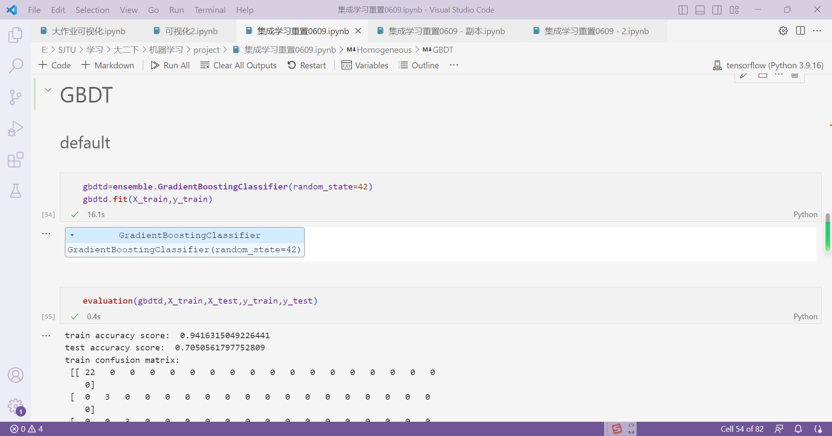
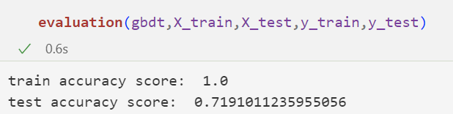
Ensemble Learning
Homogeneous
Evaluation of GBDT
GBDT
Easy to overfit and slow
Gradient Tree Boosting or Gradient Boosted Decision Trees (GBDT) builds an additive model in a forward stage-wise fashion; it allows for the optimization of arbitrary differentiable loss functions.
Gradient Boosted Decision Trees is sensitive to outliers. Because of the dependency between classifiers, GBDT is difficult to perform parallel computation.
At the same time, GBDT has a very slow running speed.

Slide 25
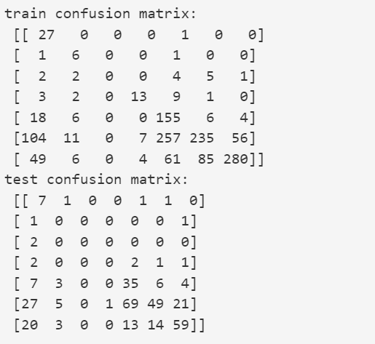
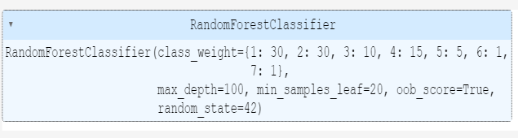
Ultimate Model
Ultimate model
——Random Forest
——(Base) estimator:DecisionTreeClassifier
Evaluation of the ultimate model
Formulation
——Combine the categories into seven categories
——Change class_weight (considering the imbalance)
——Use confusion matrix to find the best parameters
——Focus on the model's ability not to misclassify junk bonds into good ones
Compared with other models obtained through traversal, the final model has higher prediction accuracy for middle and low grades.
Also, it alleviates overfitting to some extent.

Slide 26
05
Implications and insights
What our model can do?

Slide 27


Rating predictions
We choose some of the best and worst predictions to do some discussion.
机器人 C1
京城股份 C2
开山股份 A1
中直股份 A2

Slide 28
Indicators
Operational
capacity
x
PE
EPS
ROE
x
Solvency
equity
multiplier
CL/L
PE
EPS
ROE
Current
ratio

Slide 29
Operational capacity
PE=Price/Earnings
relatively stable
about20-40
ridiculous number
such as -50+ or 1000+

Slide 30
Operational capacity
EPS&ROE
high
low or even negative

Slide 31
Solvency
Equity multiplier
no obvious different

Slide 32
Solvency
Current liabilities/liabilities
relatively low
more than half

Slide 33
Solvency
Current ratio
about 2
a perfect range
very low

Slide 34
Insight
A
safe
risky
C

Slide 35
Final Report
Thanks For Listening

